Slide 1
Lab 11 Monitor
TA: Shun Yao Chang
Professor: Hsung-Pin Chang
Operating System Lab

Slide 2
Monitor
A high-level abstraction that provides a convenient mechanism for process synchronization.
Encapsulate private data with public method
Variables can be accessed by only the local procedures.
Only one process may be active within the monitor
at a time.

Slide 3
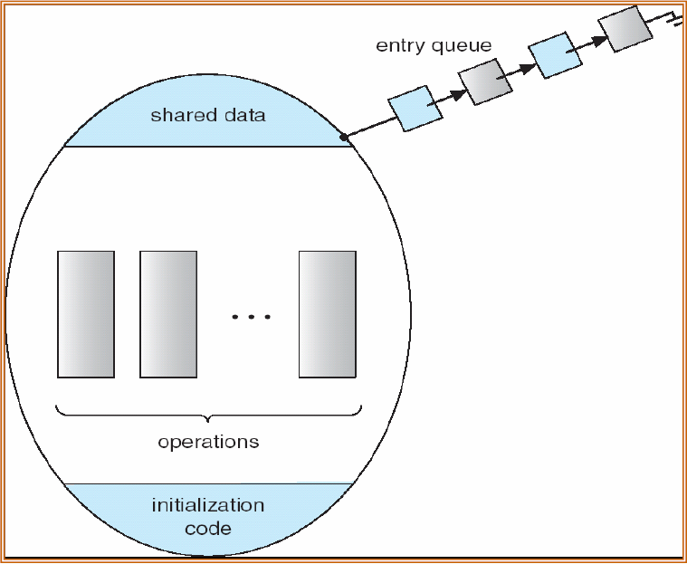
Schematic View of a Monitor

Slide 4
Condition Variable
To allow a process to wait within a monitor.
A condition variable must be declared as condition x;
Two operations on a condition variable x
x.wait()
x.signal()

Slide 5
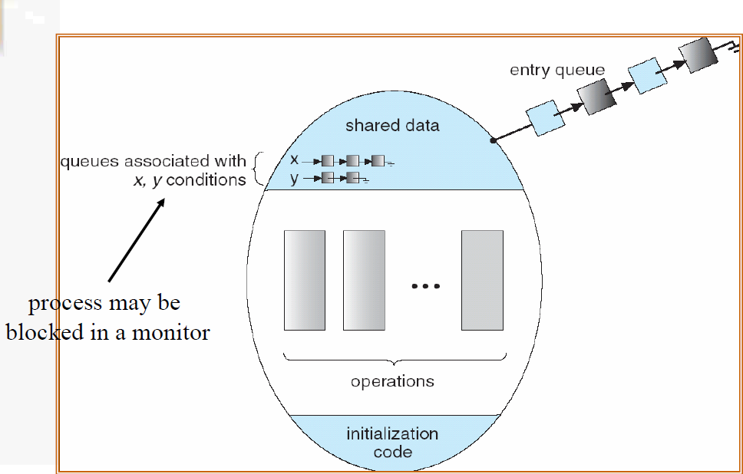
Monitor with Condition Variables

Slide 6
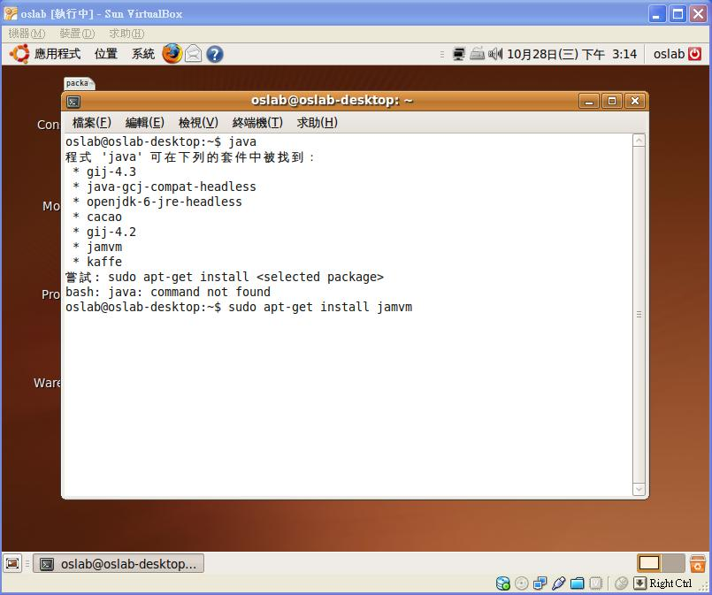
Install the Java Virtual Machine

Slide 7
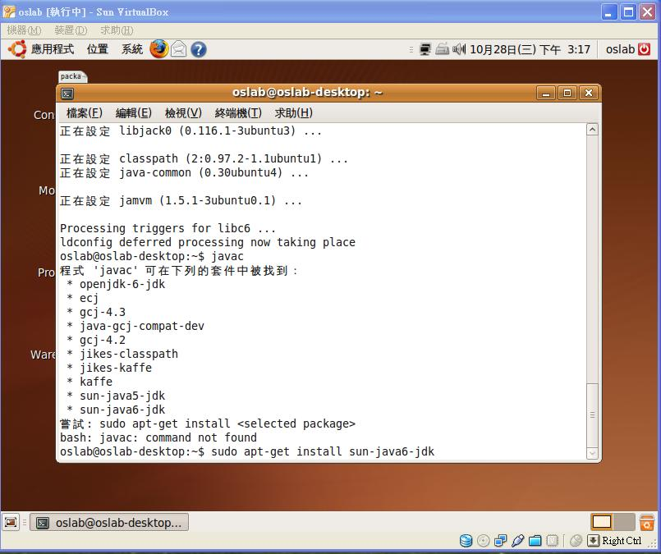
Install the Java Virtual Machine (Cont.)

Slide 8
Install the Java Virtual Machine (Cont.)
Notice: If your Ubuntu version is above 10.04, you should install openjdk instead of sun java jdk.
The command is sudo apt-get install openjdk-6-jdk.
You still can install sun-java-jdk by taking some steps(see reference)

Slide 9
JAVA Monitor
There are two methods for monitor-like mechanisms in Java.
Synchronized
Lock

Slide 10
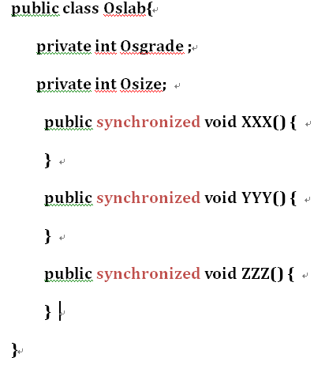
Synchronized
Synchronized

Slide 11
Example 1
A program declares a global variable count and then creates three identical threads.
Each thread increments the same global variable 25,000,000 times.
So count is incremented a total of 75,000,000 times.
The main program waits for the three threads to
complete.
Using the Synchronized to solve race condition problem.

Slide 12
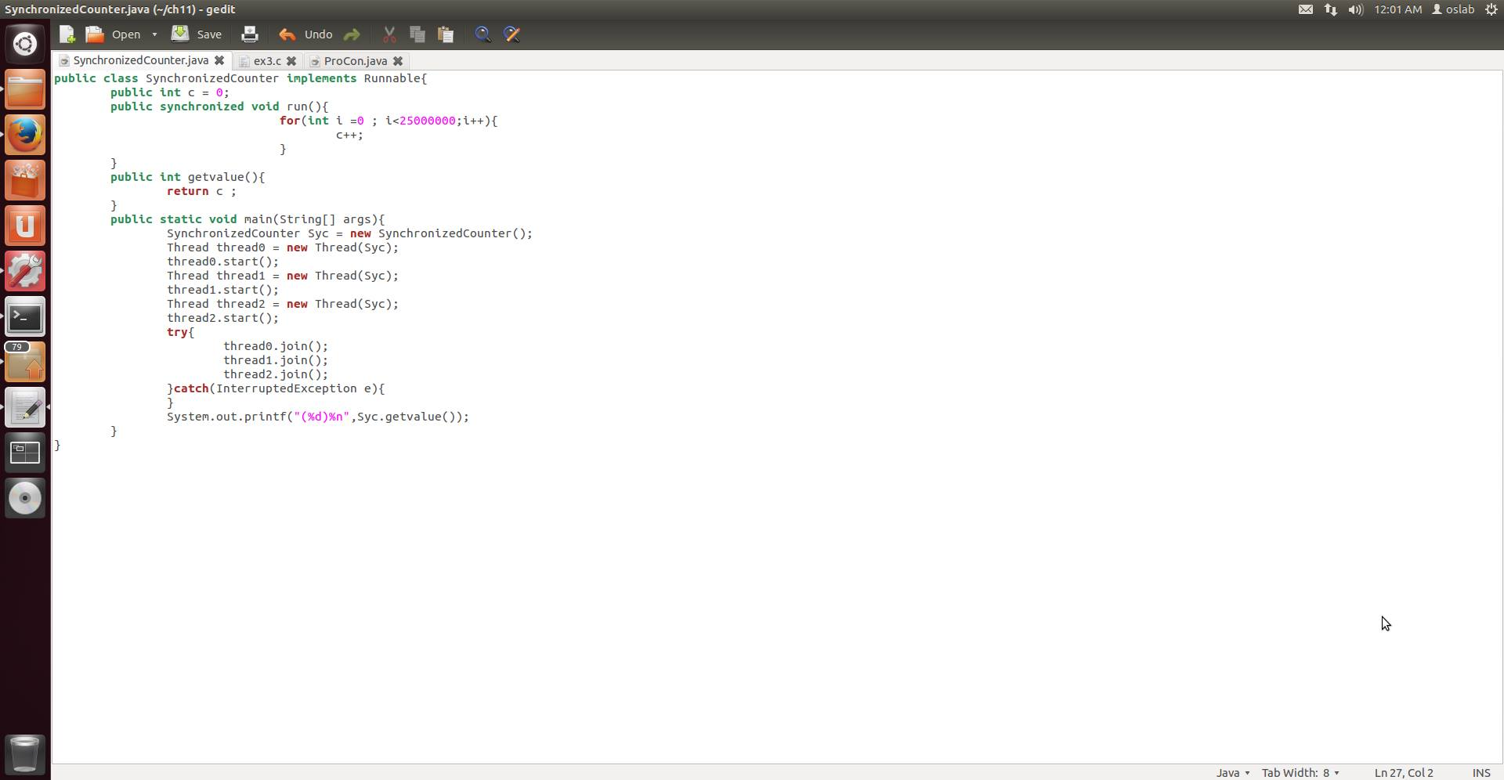
Example 1 (cont.)

Slide 13
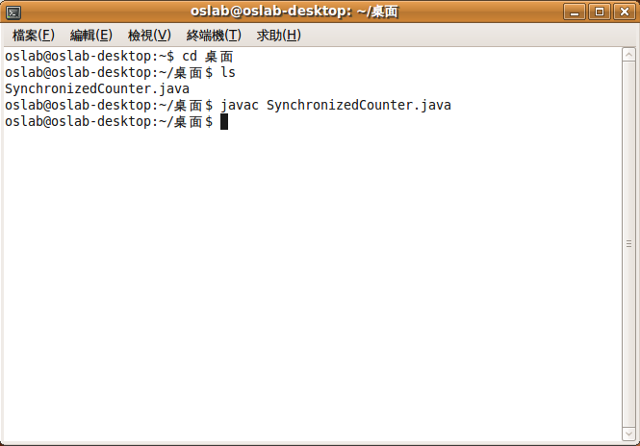
Example 1 (cont.)

Slide 14
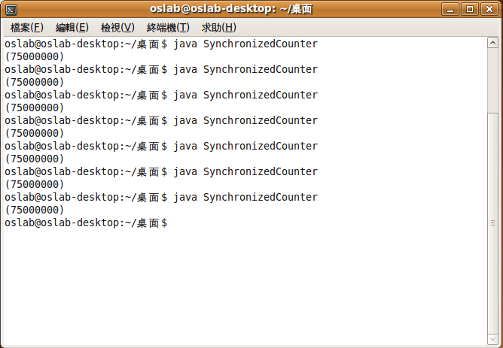
Example 1 (cont.)

Slide 15
Exercises 1
Using Java Language to do the same work shown in the final example of the Lab10 ( “Semaphores”) .[+35pt.]
Using Synchronized to solve the race condition occurred.[+35pt.]

Slide 16
JAVA Monitor
There are two methods for monitor-like mechanisms in Java.
Synchronized
Lock

Slide 17
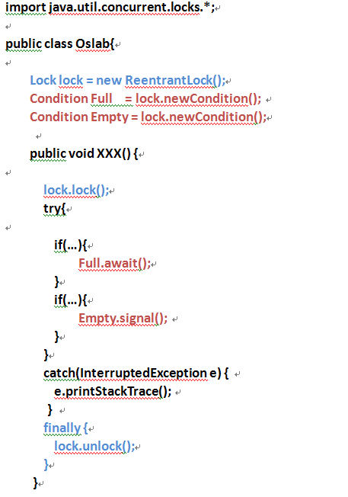
Lock
Lock

Slide 18
Example 2
As an example, suppose we have a Warehouse which supports ”setProduct ” and “getProduct” methods.
If a ”getProduct” is attempted on an empty warehouse, then the thread will block until an item becomes available.
If a ”setProduct” is attempted on a full warehouse, then the thread will block until a space becomes available.
Using the Lock to solve race condition problem.

Slide 19
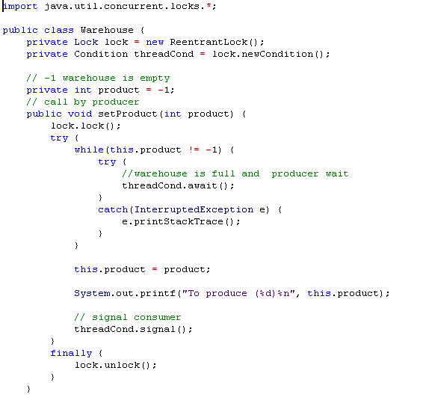
Example 2(cont.)

Slide 20
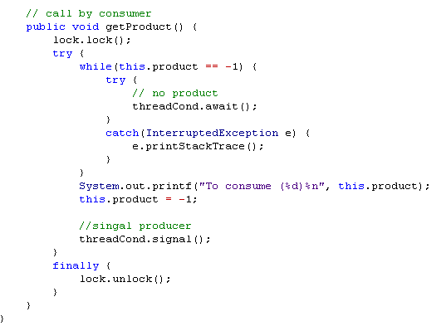
Example 2 (cont.)

Slide 21
Exercises 2
Using the Java Lock to solve the multiple Producer-multiple Consumer Problem. [+20pt.]
Constraint:
The maximum amount of product is 10.
The minimum amount of product is 0.
If the total amount of product is zero and consumer want to consume, print “empty” on the screen.
If the total amount of product is ten and producer want to produce, print “full” on the screen.
Print every transaction.

Slide 22
Exercises 2(cont.)

Slide 23
References
Java Gossip: Lock and Condition
http://caterpillar.onlyfun.net/Gossip/JavaGossip-V2/LockAndCondition.htm
Java API
http://java.sun.com/j2se/1.5.0/docs/api/java/util/concurrent/locks/Condition.html
How to install Sun Java Runtime in Ubuntu 10.04 (Lucid Lynx)
http://www.ubuntugeek.com/how-install-sun-java-runtime-environment-jre-in-ubuntu-10-04-lucid-lynx.html

Slide 24
Class X{
private final Semaphore avai = new Semaphore(1);
// ...
public void m(){
try {
avai.acquire();
// ... do someting
avai.release();
} catch (InterruptedException e) {
e.printStackTrace();
}
}
}
class X {
synchronized public void syncMethod() {
......
}
}
class X {
private final ReentrantLock lock = new ReentrantLock();
// ...
public void m() {
lock.lock(); // block until condition holds
try {
// ... method body
} finally {
lock.unlock()
}
}
}

